Slide 1
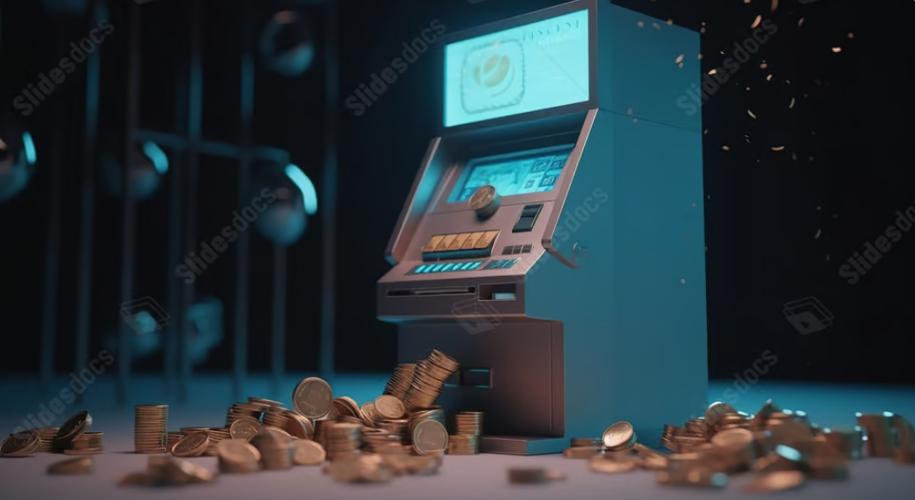
ATM_Using Verilog
Presented to :
Dr. Eman El Mandouh ​
Supervised by:
Eng. Kareem Waseem ​
DEC
2023

Slide 2
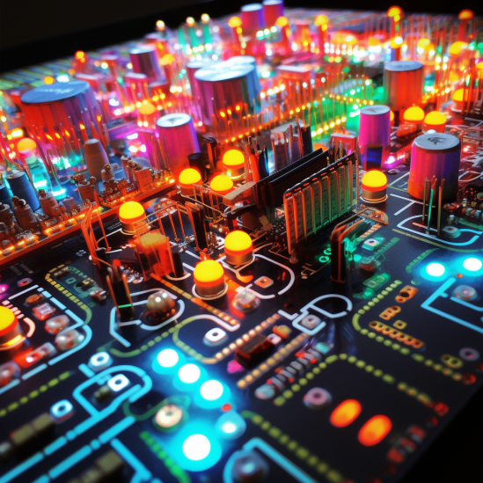
Family Members
Omar Ahmed Gomaa 22p0109
Mohammed Yasser 2100921
Adham Osama Mohamed 22P0071
Omar Osama Abdelkarim 2101757
Mohamed Ahmed 2001038
Sara Mohamed Ashour 21p0337

Slide 3

AGENDA
FSM Diagram
Reference Module
Module
Testing

Slide 4
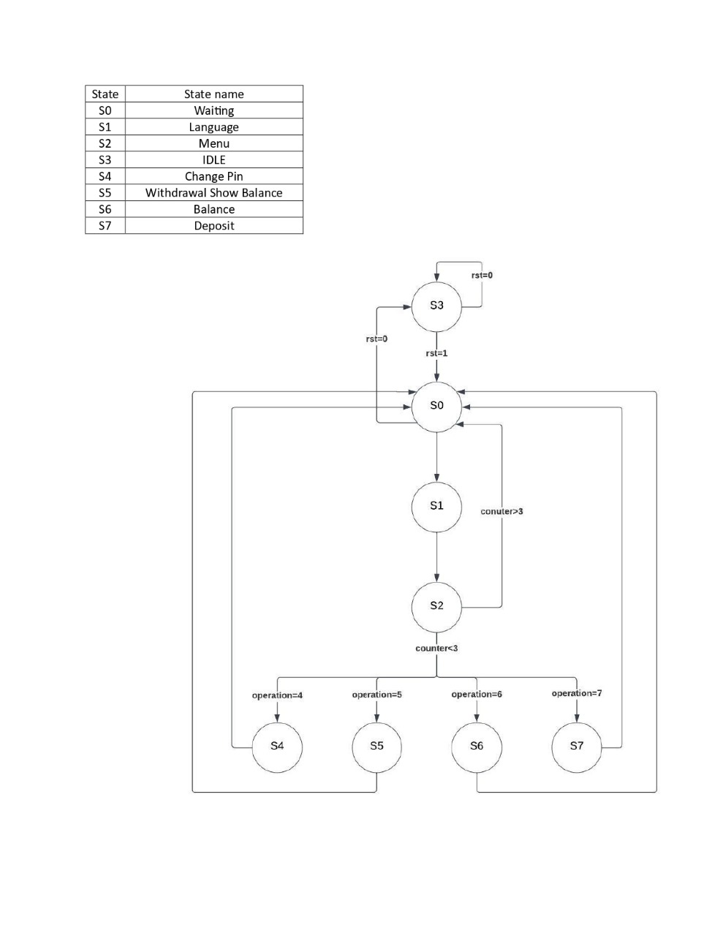
FSM diagram

Slide 5

Reference Module

Slide 6
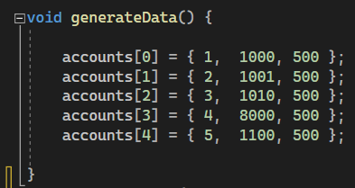
FIRST WE CREATE SOME DATA

Slide 7
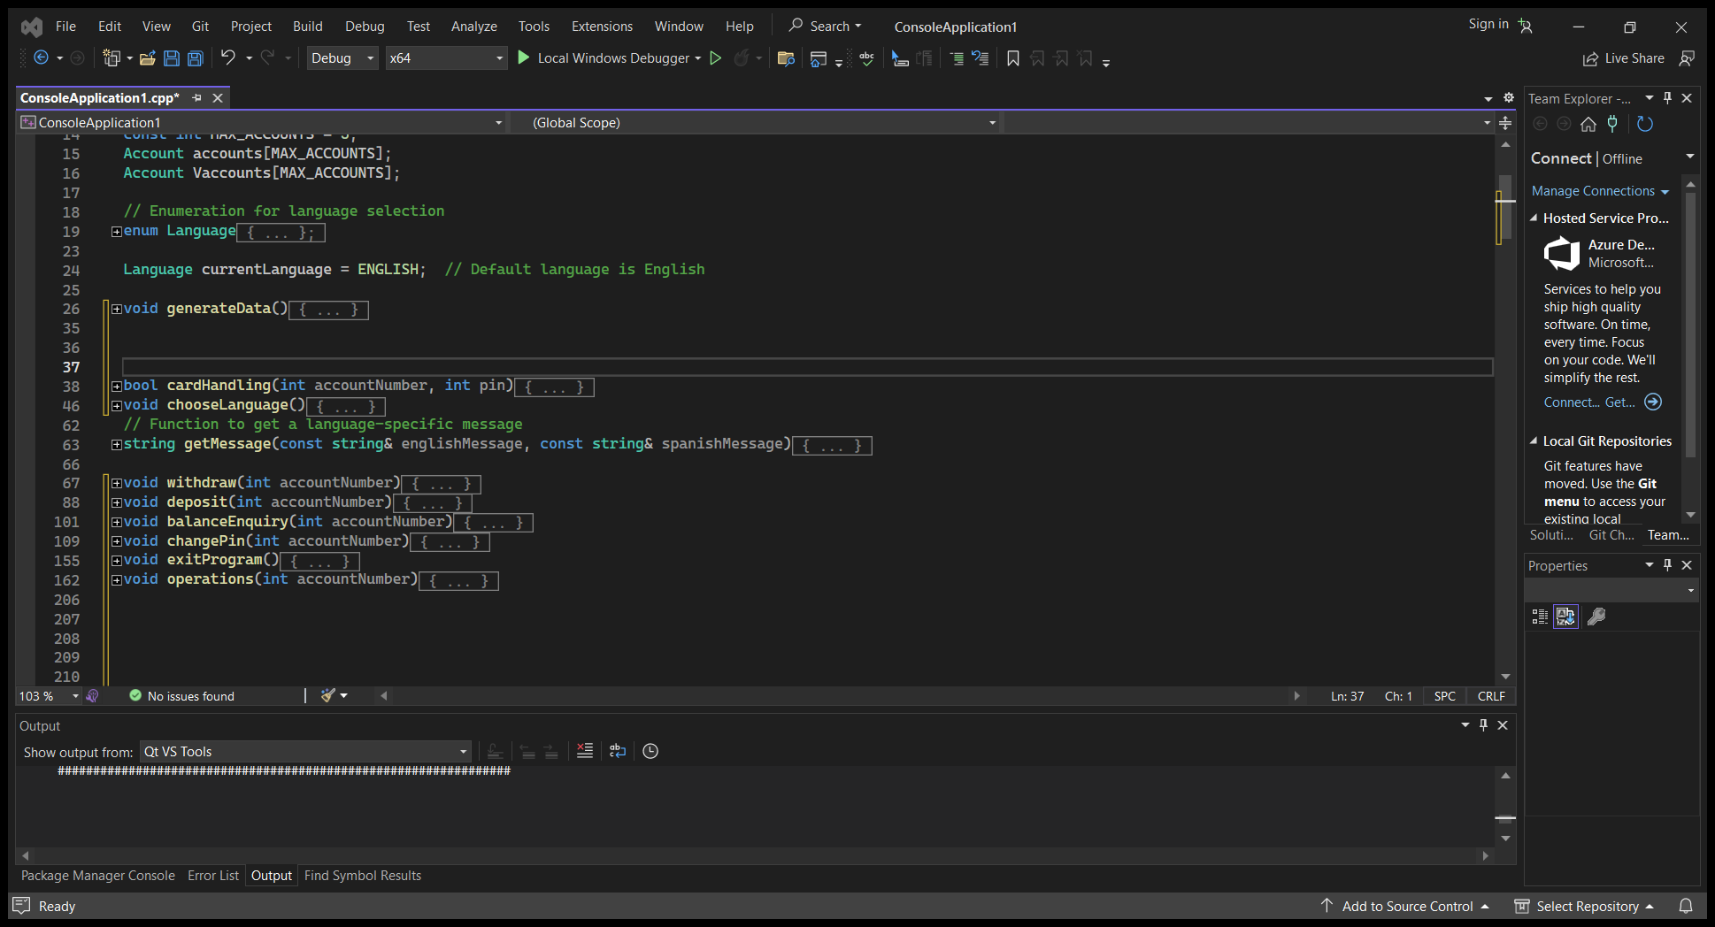
THEN WE CREATE OUR FUNCTIONS

Slide 8
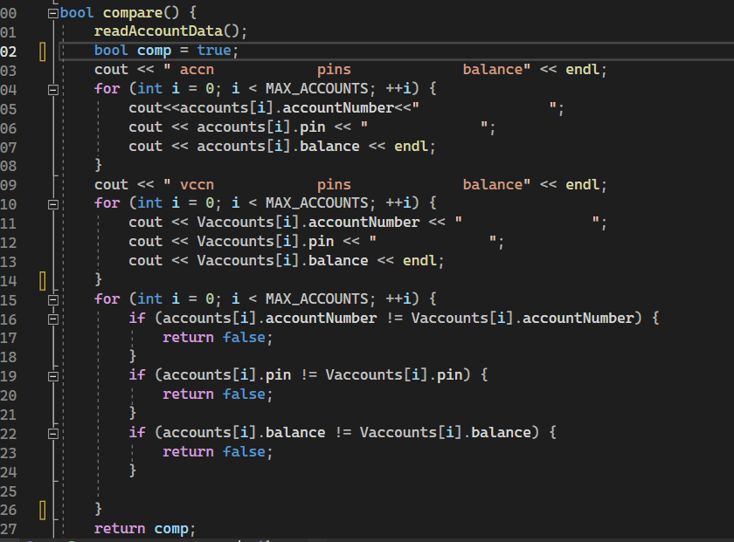
FINALLY WE COMPARE OUR ANSWERS

Slide 9
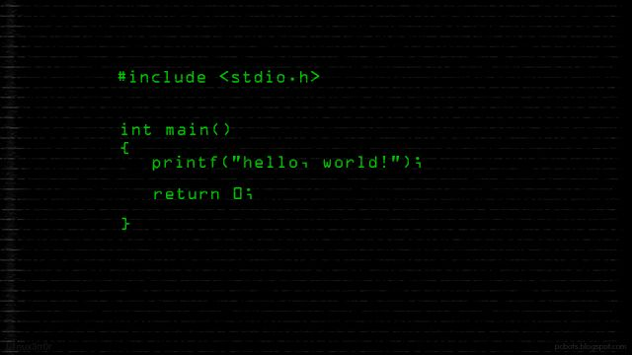

Slide 10
DATABASE

Slide 11

DATABASE
Just holding user data
(account number-password)
And change the password

Slide 12
DATABASE
ATM

Slide 13
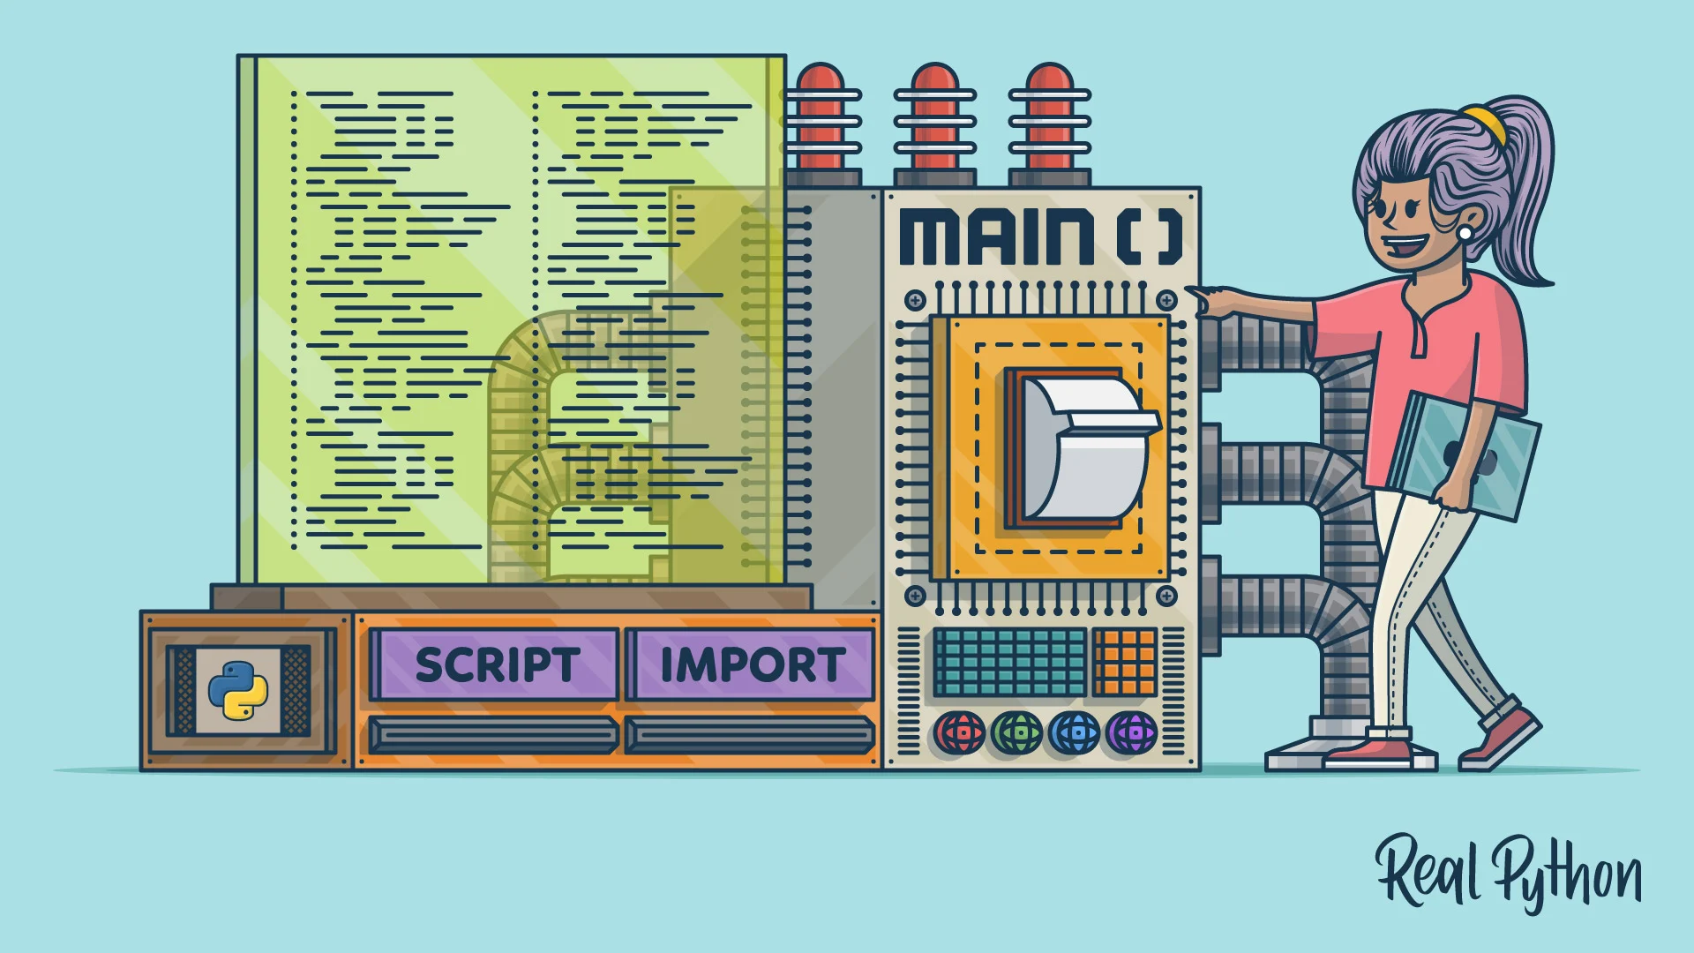
ATM
Having all the functions and holds the balance of users

Slide 14
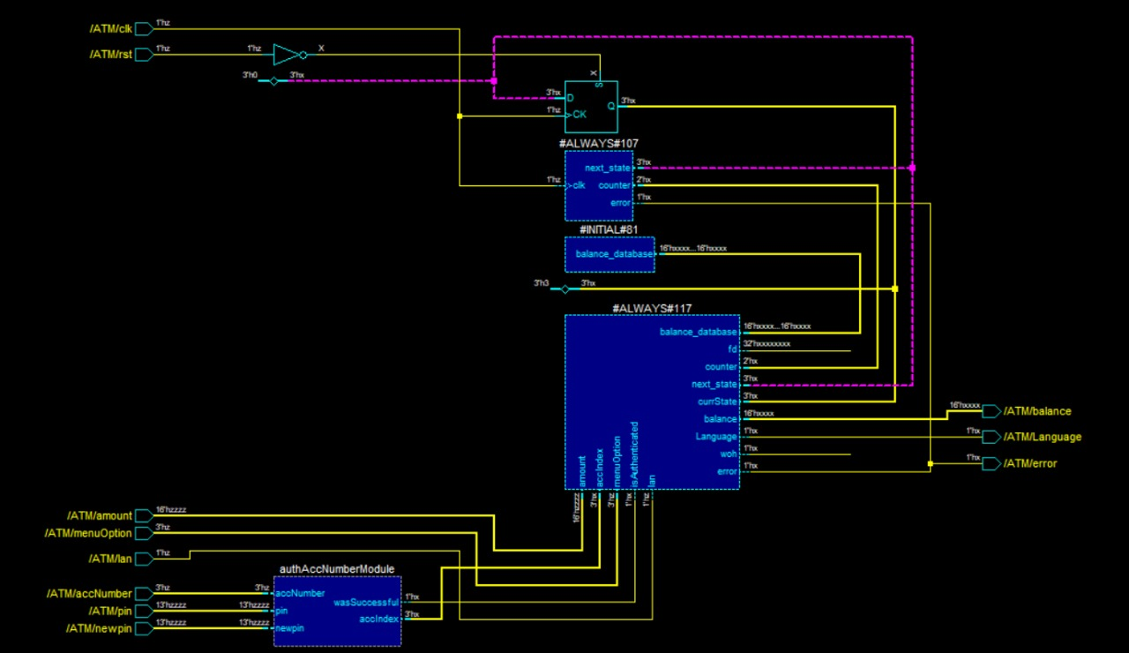

Slide 15
TEST BENCH
DATABASE
ATM

Slide 16

TEST BENCH
Manages all test cases and responsible of saving data into text file

Slide 17
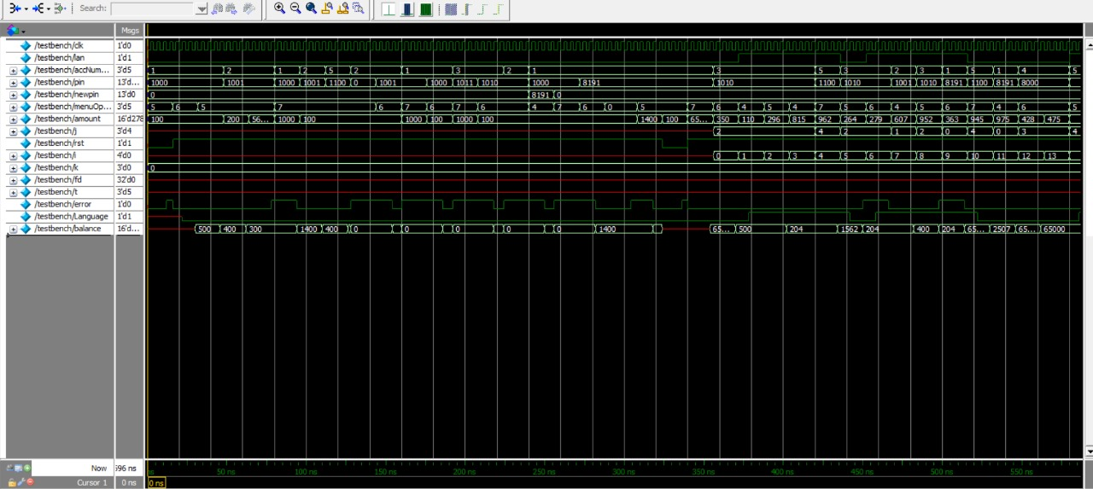

Slide 18


Slide 19
DIRECT TESTING

Slide 20
Direct Test
 | ACC | PASS | OPERATION | INPUT | OUTPUT | STATE
Test 1 | 1 | 1000 | DRAW | Amount=100 Rst=0 | Balance =500 | S
Test 2 | 1 | 1000 | DRAW | Amount=100 | Balance =400 | S
Test 3 | 2 | 1001 | DRAW | Amount=200 | Balance =300 | S
Test 4 | 2 | 1001 | DRAW | Amount=56270 | Error=1 Balance =300 | S
Test 5 | 1 | 1000 | DEPOSIT | Amount=1000 | Balance =1400 | S
Test 6 | 2 | 1001 | DEPOSIT | Amount=100 | Balance =400 | S
Test 7 | 5 | 1100 | DEPOSIT | Amount=100 | Balance =600 | S

Slide 21
Direct Test
 | ACC | PASS | OPERATION | INPUT | OUTPUT | STATE
Test 8 | 2 | 0000 | DEPOSIT | Amount=100 | Error=1 Balance =400 | S
Test 9 | 1 | 1001 | DEPOSIT | Amount=1000 | Error=1 Balance =1400 | S
Test 10 | 3 | 1011 | DRAW | Amount=1000 | Error=1 Balance =500 | S
Test 11 | 10 | 1010 | SHOW B. | Amount=0 | Error=1 | S
Test 12 | 1 | 1000 | CHANGE PIN | NEW PIN=8191 | _ | S
Test 13 | 1 | 8191 | SHOW B. | _ | Balance =1400 | S
Test 14 | 1 | 8191 | _ | _ | TIMER IS OUT | S

Slide 22
DIRECT TESTING
ASSERTIONS

Slide 23
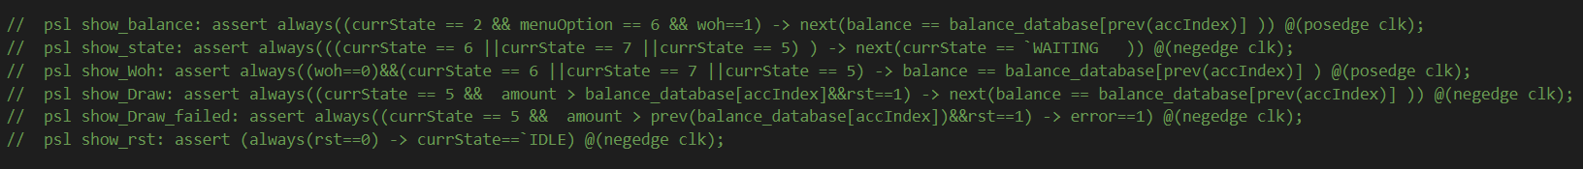

Slide 24
DIRECT TESTING
RANDOM TESTING
ASSERTIONS

Slide 25
TESTING
41%
59%
Direct
Random

Slide 26


